Slide 1
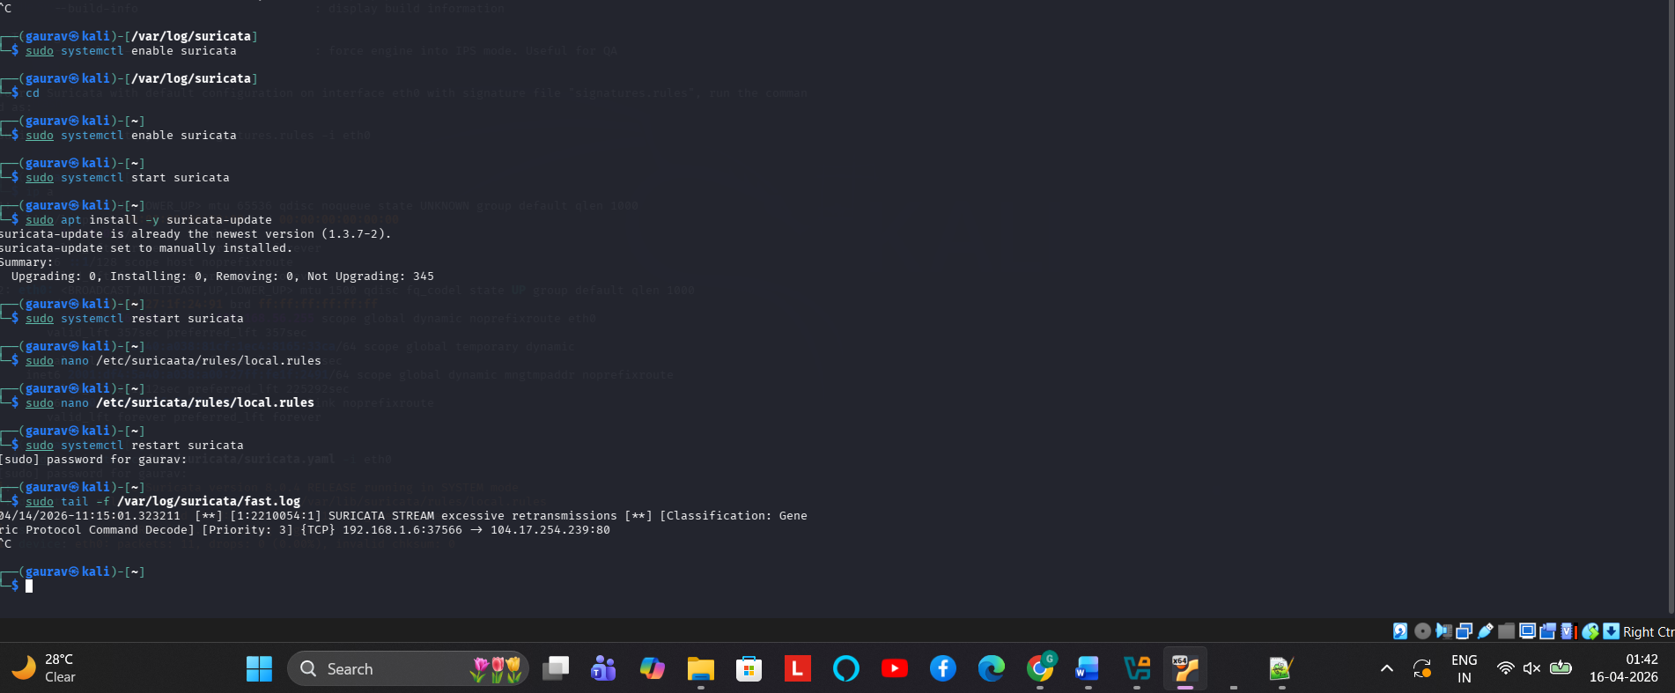
PH3- SURICATA- FAST.LOG

Slide 2
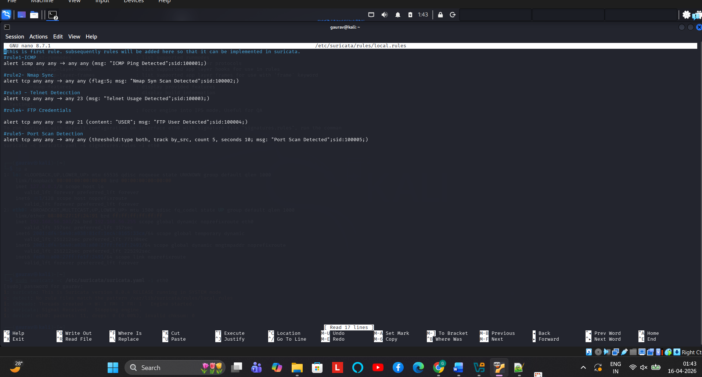
PH3- SURICATA- LOCAL.RULES

Slide 3
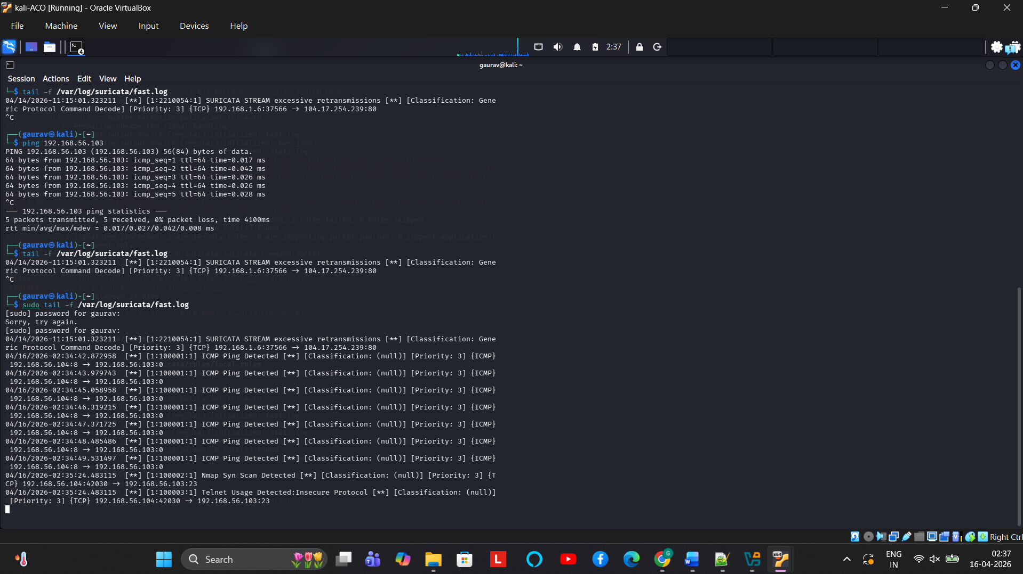
PH3 –SURICATA- SUCCESSFUL IDS

